Slide 1
Project Title
E-commerce Sales analysis using Power BI
Desing By :
Rakesh Reddy Gopireddy

Slide 2
Introduction
I use E-commerce Dataset For This Project .
The objective of this project is to analyses eCommerce sales data to identify sales trends, top-performing products, and customer purchasing behaviour
Why Analysis is important means from analysis we can find the solutions for problem that means for create a visualization of raw data we can achieve in which area sales are increases or decreases, and we find which product is more sales and we top performing customer. Like this type of question we analyse for using Analysis.

Slide 3
Data Cleaning Process
Main important In Data Analysis Collecting and Cleaning Is important and Q&A form customer.
In this project I use sales data in that data I collect Data From Google Source and Kaggle etc… I took data from this sources.
After that I Cleaned the data using Power Query in That I cleaned missing values, Duplicates and Corrected data types and Spaces for that I use TRIM option etc….
Process of Data cleaning:
Open Power BI
Load Data
Transform Data into Power Query
Cleaning

Slide 4
Data Analysis Process
Sales data was aggregated by region and category and total sales to identify high-performing markets.
For Aggregated I used DAX (Data Analysis Expressions) Measures For Calculation of Product sales and performing .
I calculate Total sales and average sales of full dataset For that I used measurement That is
For Total Sales :
Total Sales = SUM(ecommerce_sales_analytics_5000[revenue])
For Average Sales:
Average Sales = AVERAGE(ecommerce_sales_analytics_5000[revenue]) etc…
And more then that I analyse Sales by Category and Daily Sales Trends and number of orders, Customer can buy and Total Sales by product Category of each region.

Slide 5
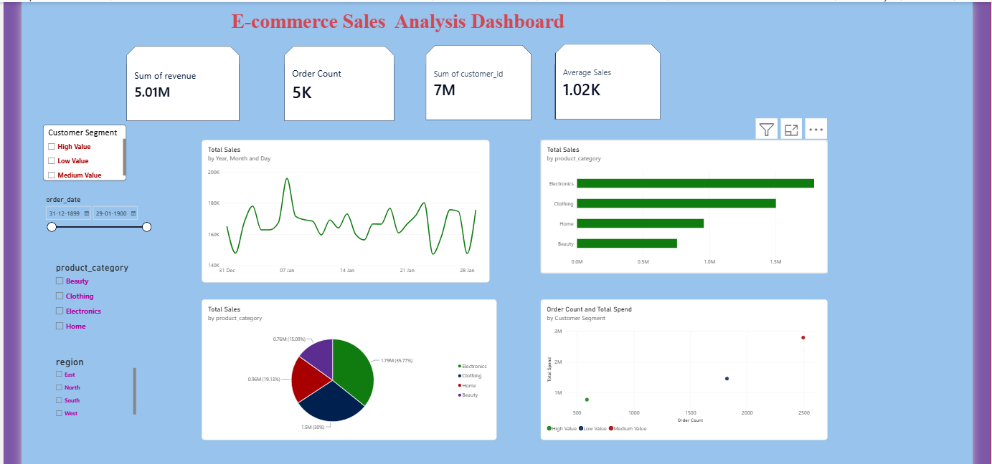
Visualizations / Dashboard
Form The Dashboard what I analyse is Day by day trends of Sales and which product get more sold and in which region Sales are high and low, This the analysis I reached out form this project.

Slide 6
Key Insights
Insight 1
Electronics is the Top-Performing as compare to others category.
Insight 2
West region is highest sales as compare to other region.
Insight 3
East region has lower Sales and presents a growth opportunity.
Recommendations
Based on the insights, suggest actions.
Increase inventory before peak sales months.
Focus marketing efforts on high-performing regions.
Promote low-selling product categories.
Improve customer retention strategies.

Slide 7
Conclusion
The analysis revealed strong seasonal sales patterns and identified Technology as the top-performing category. Implementing targeted marketing and inventory planning can further improve business performance. Implementing targeted of low price product to improve that sold and performance.

Slide 8
Thank You

